Slide 1


Advanced JS - Test

Slide 2
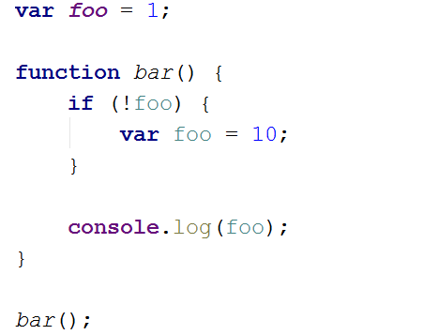
Question 1
Q : what is the console output?
Notes:
Tested Knowledge : JS function scope vs java like block scope
# Solution ``` 10 ``` # Why? `var foo` at line 5 is hoisted at the top of the function like so: ```javascript function bar() { var foo; // <-- hoisted declaration if (!foo) { foo = 10; // <-- affectation only } console.log(foo); } ``` # Good to know If we remove `var` at line 5, the result change to `1`. `foo` isn't declared in the function so the `foo` from line 1 is used.

Slide 3
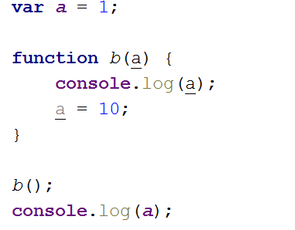
Question 2
Q: what is the console output?
Notes:
Tested Knowledge : method param are scoped to the method, and primitive method param are passed by copy
# Solution ``` undefined 1 ``` # Why? An omitted parameter is evaluated as `undefined`. The `a` variable in the function is a local parameter, so the `a` variable from line 1 is not updated by the function. # Good to know Calling `b(a)` will display ``` 1 1 ``` The the affectation line 5 does not update the value of the global as functions use call-by-sharing.

Slide 4
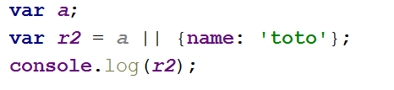
Question 3
Q: what is the console output?
Notes:
Tested Knowledge : || logical syntax
# Solution ``` { name: 'toto' } ``` # Why? In Javascript, a boolean operations are evaluated from left to right and return the last evaluated term. This can be counter-intuitive as we may think that a boolean operation will only return a boolean value. # Good to know This syntax is commonly used to create a fallback to a default value for an `undefined` parameter. ```javascript function createMyWidget(title, width, height) { title = title || 'Default title'; width = width || '100%'; height = height || '200px'; console.log('============================'); console.log('Widget created with config:'); console.log('title:', title); console.log('width:', width); console.log('height:', height); } createMyWidget('My custom title', '50%'); createMyWidget(); ```

Slide 5
Question 4
Q: what is the console output?
Notes:
Tested Knowledge : && logical syntax
# Solution ``` tt ``` # Why? In Javascript, a boolean operations are evaluated from left to right and return the last evaluated term. This can be counter-intuitive as we may think that a boolean operation will only return a boolean value. # Good to know The function declaration is evaluated as `truthy`. The `console.log(b);` in the function is not executed as the function is only declared and not executed.

Slide 6
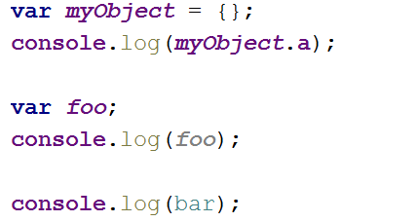
Question 5
Q: what is the console output?
Notes:
Tested Knowledge : value of an undefined / undeclared var depending if it's a property or directly a var
# Solution ``` undefined undefined ReferenceError: bar is not defined ``` # Why? An unknown property of an object is evaluated as `undefined`. A declared but not initialized variable is evaluated as `undefined`. Accessing an undeclared variable result in an error. # Good to know Trying to access `myObject.a.b` would also result in an error, as accessing a property of an undefined variable is not permitted. To safely access `b`: `var myBValue = myObject.a && myObject.a.b;`

Slide 7
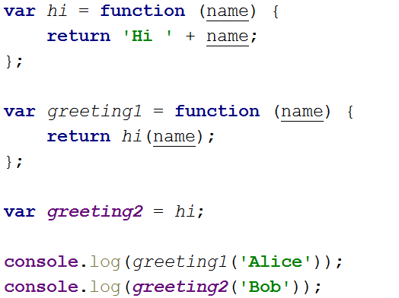
Question 6
Function
Q: what is the console output?
Notes:
Tested Knowledge : a function is a var
# Solution ``` Hi Alice Hi Bob ``` # Why? Both methods works as having a variable reference a function is a valid Javascript syntax.

Slide 8
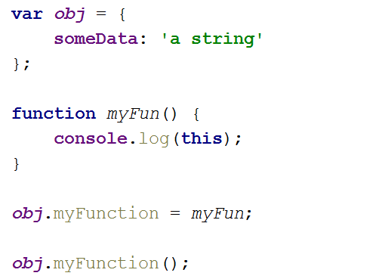
Question 7
What is this ?
Q: what is 'this' when shown on the console ?
Notes:
Tested Knowledge : this on an object
# Solution ``` { someData: 'a string', myFunction: [Function: myFun] } ``` # Why? `this` refers to the object the function have been called on. Here the object is `obj`, which have a property maned `someData` and a function named `myFunction`.

Slide 9
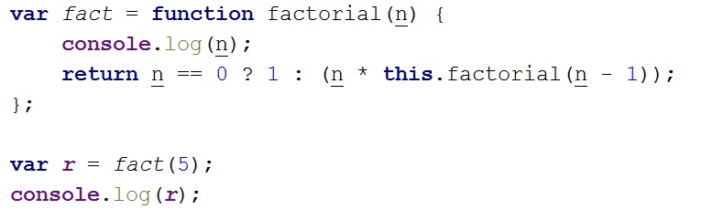
Question 8
Q: It does not work ? Why ?
Idea to make it work ?
Notes:
Tested Knowledge : this is not the function itself !
# Solution It doesn't work. To fix it remove `this.` at line 3: ```javascript var fact = function factorial(n) { console.log(n); return n == 0 ? 1 : (n * factorial(n - 1)); }; ``` # Why? In the function `this` is equivalent as `global` which does not have a function called `factorial`, `factorial` is only a local name.

Slide 10
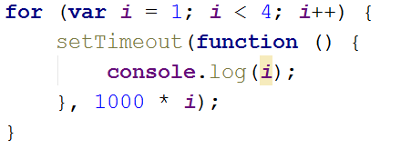
Question 9
Scope again
Q: what is the console output?
Notes:
Tested Knowledge : a classic closure
# Solution ``` 4 4 4 ``` # Why? The `i` variable is incremented synchronously. When the timeouted-functions are called, the `i` var have already reach it last state at value `4`. # Good to know Here are some solutions: ```javascript // Fix version 1 for (var i = 1; i < 4; i++) { setTimeout(function (x) { return function () { console.log(x); }; }(i), 1000 * i); } ``` ```javascript // Fix version 2 function myCallBackClosured(x) { return function () { console.log(x); }; } for (var i = 1; i <= 5; i++) { setTimeout(myCallBackClosured(i), 1000 * i); } ``` ```javascript // Fix version 3 for (var i = 1; i <= 5; i++) { (function (i) { setTimeout(myCallBack, i * 1000); function myCallBack() { console.log(i); } })(i); } ```

Slide 11
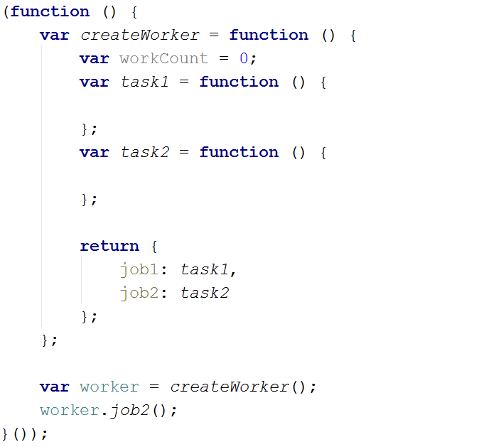
Question 10
I.I.F.E.
Q: what is the purpose of the (function () { ... }()); syntax?
Notes:
Tested Knowledge : IIFE
# Solution It prevent polluting the `global` scope. # Why? As everything is function-scoped, every variable or function declared inside an IIFE are only valid in this IIFE, keeping `global` scope pristine. # Good to know ```javascript (function () { var myVar = 4; }()); console.log(myVar); ``` Will result in an error `ReferenceError: myVar is not defined`, showing that the `myVar` declared inside an IIFE is not accessible outise the IIFE scope.

